Slide 1

IEEE FRAUD DETECTION
Apache Spark ETL & MLlib Implementation
Presented By: Akshay
Course: Artificial Intelligence & Machine Learning

Slide 2

EXECUTIVE ABSTRACT
"This project develops a high-performance fraud detection system leveraging Apache Spark to process e-commerce transactions. With a sparse fraud distribution of only 3.52%, the system employs an automated ETL pipeline and Spark MLlib classifiers to ensure financial security at scale."

Slide 3


THE CHALLENGE OF FRAUD
Growth of Digital Payments
Online shopping surges have amplified fraudulent activities, costing billions annually. Legacy systems fail to handle the Volume, Velocity, and Variety of modern transaction data.
Real-time protection needs.
Distributed computing requirement.
Advanced pattern recognition.

Slide 4




PROBLEM STATEMENT
Core Issue
Technological Gap
Standard data processing frameworks buckle under millions of records. Detecting fraudulent transactions accurately while maintaining low latency is a critical engineering hurdle for financial institutions.
Traditional machine learning workflows are often non-scalable. This project bridges the gap using Apache Spark's distributed architecture for robust, industrial-grade fraud detection.

Slide 5
MISSION OBJECTIVES
Build a scalable Spark ETL pipeline.
Train four diverse MLlib classifiers.
Integrate Transaction and Identity data.
Evaluate via ROC-AUC and F1-Scores.
Automate feature engineering stages.
Optimize performance via GBT models.
Handle extreme class imbalances.
Ensure Parquet-optimized storage.

Slide 6






TECHNOLOGY ECOSYSTEM
PySpark
Spark SQL
MLlib
Parquet
Distributed Python API for Spark core.
Querying and merging massive datasets.
Scalable ML algorithms and pipelines.
Optimized columnar data storage.

Slide 7

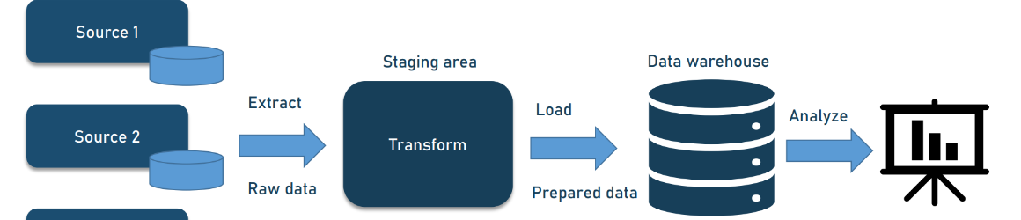
PROJECT WORKFLOW PIPELINE
ETL
PREPROCESS
ENGINEER
TRAIN
EVALUATE
FINALIZE
Extract & Merge
Cleaning & Impute
Encode & Scale
MLlib Parallelism
Metrics & Analysis
Optimal Selection

Slide 8


IEEE-CIS DATASET PROFILE
Transactional Core
Identity Metadata
Real-world Vesta e-commerce data featuring columns for Card Type, Email Domains, Amount, and Product Code. High-volume files forming the backbone of the study.
Enriching data with Network, Browser, and Device information. Crucial for detecting botnets and sophisticated fraudulent multi-account patterns.

Slide 9
THE NEEDLE IN A HAYSTACK
3.5%
Extreme class imbalance is the primary challenge. Standard accuracy fails as a metric here.
96.5% Legitimate Transactions.
Fraudulent Samples
Metric Focus: Precision, Recall, ROC-AUC.

Slide 10
FEATURE CATALOG DETAIL
Feature Category | Sub-features | Analytical Purpose
Card Metadata | card1 - card6 | Payment type and issuing bank analysis
Time Deltas | D1 - D15 | Days between transactions; behavior shifts
Counting Features | C1 - C14 | Address associations and card frequency
Identity Details | id_01 - id_38 | Device types, browser info, and network reputation
Email/Addr | P_email, R_email, addr1 | Geographical and domain-based risk assessment

Slide 11
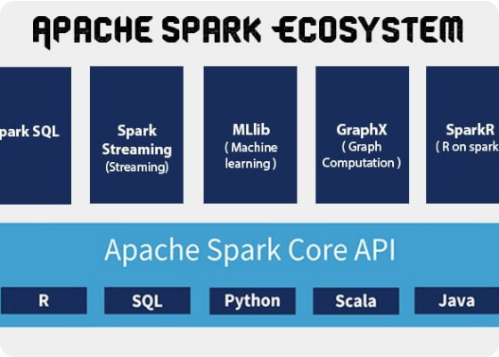
ETL PHASE 1: INGESTION
Parallel Data Ingestion
Spark's distributed architecture reads the transaction and identity files concurrently across the cluster.
Key Join: Merged on TransactionID.
Sparse Pruning: Drops empty ID metadata.
Memory Mgmt: Optimized schema inference.

Slide 12
ETL PHASE 2: TRANSFORMATION
Cleaning
Imputation
Formatting
Removal of duplicates and high-correlation redundant masked variables to reduce model noise.
Handling missing numerical data via median/mean and categorical data via "Unknown" tags.
Standardizing timestamp-based columns and normalizing currency denominations.

Slide 13
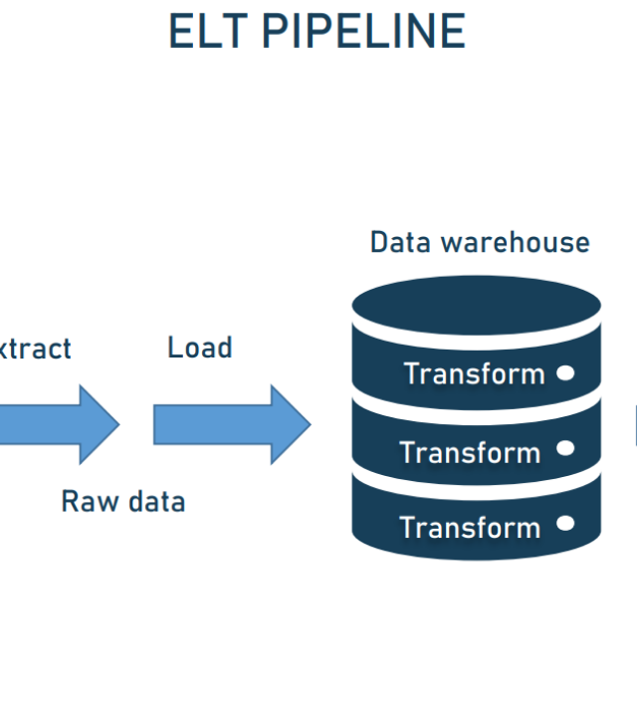
ETL PHASE 3: LOADING
The Power of Parquet
Storing the finalized dataset in Apache Parquet format ensures:
High compression ratios (saving disk space).
Column-level reading (faster queries).
Readiness for Big Data warehouse loads.

Slide 14
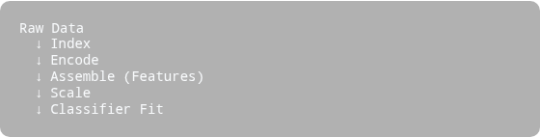
SPARK MLLIB PIPELINE
Sequential Transformation
Logic flow:
Spark ML Pipelines bundle transformations into an atomic workflow.
StringIndexer: Labels to Indices.
OneHotEncoder: Vector expansion.
VectorAssembler: Merging columns.
StandardScaler: Unit variance scaling.

Slide 15


CANDIDATE MODELS: BATCH 1
Logistic Regression
Decision Tree
The baseline model. Used to establish a linear performance boundary. Fast and interpretable, but lacks depth for non-linear fraud patterns.
A non-parametric model that builds logical rules. It captures feature interactions but is highly prone to overfitting and bias in imbalanced sets.

Slide 16


CANDIDATE MODELS: BATCH 2
Random Forest
Gradient Boosted Trees
Bagging ensemble method. Trains multiple trees on subsets of data to reduce variance. Highly stable for fraud datasets.
Boosting ensemble. Sequentially trains trees to correct errors of predecessors. The powerhouse of modern classification.

Slide 17
COMPARATIVE RESULTS MATRIX
Algorithm | Accuracy | Precision | Recall | ROC-AUC
Logistic Regression | 97.18% | 96.77% | 97.18% | 85.76%
Decision Tree | 97.52% | 97.25% | 97.52% | 20.72%
Random Forest | 97.36% | 97.20% | 97.36% | 86.71%
GBT Classifier | 97.63% | 97.43% | 97.63% | 89.76%

Slide 18
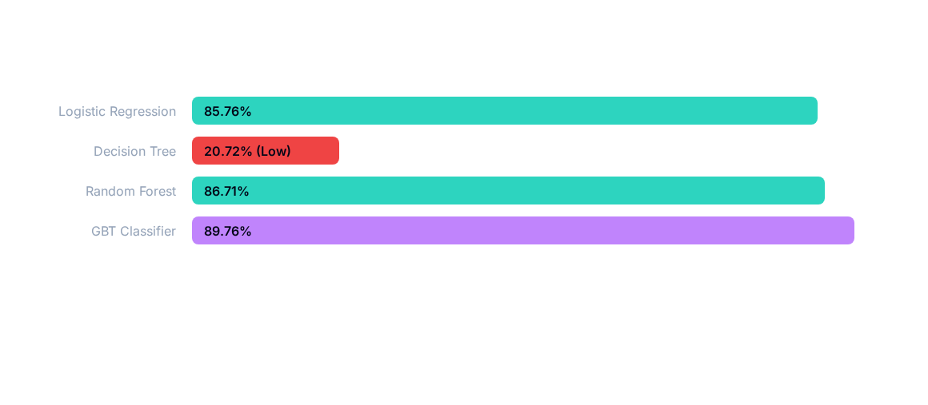
METRIC PERFORMANCE: ROC-AUC
Note: ROC-AUC represents the model's ability to distinguish between classes. GBT leads significantly.

Slide 19
THE EVALUATION DILEMMA
Accuracy Trap
The GBT Edge
Decision Tree accuracy (97.5%) looks great, but ROC-AUC (20.7%) is terrible. This proves the model is just predicting the majority class (Legit) correctly while failing to catch actual Fraud.
With an ROC-AUC of 89.76%, GBT provides the best separation between Fraud (1) and Legit (0) transactions, making it the only viable choice for a production environment.

Slide 20
KEY PERFORMANCE WINNER
89.7%
Optimal ROC-AUC Score
Achieved by Gradient Boosted Trees Classifier.

Slide 21






PROJECT STRENGTHS
Scalability
Automation
Speed
Handles GBs of data across Spark nodes effortlessly.
End-to-end ML Pipeline for consistent preprocessing.
Distributed training is 10x faster than single-node Sklearn.

Slide 22
SYSTEM CONSTRAINTS
Class Imbalance
Resource Demand
Even with GBT, the extreme sparse nature of fraud data limits absolute recall without increasing false positives.
Large Spark clusters require significant RAM and CPU overhead, impacting operational costs for smaller institutions.

Slide 23



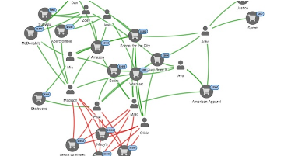
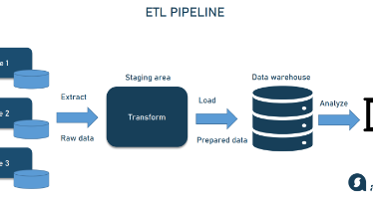

FUTURE HORIZONS
Real-time Streaming Integrating Spark Structured Streaming for live alerts.
Deep Learning Deploying LSTM/CNN nodes for sequence-based fraud.
Explainable AI Using SHAP values for model interpretability.

Slide 24
CONCLUSION
This research validates Apache Spark as a powerful engine for building industrial fraud detection systems. By automating the ETL lifecycle and identifying GBT as the superior classifier, I have established a framework capable of handling modern financial threats with high reliability and efficiency.

Slide 25
Questions & Answers
Thank you for your time.
Project By: Akshay
Artificial Intelligence & Machine Learning Specialist

Slide 26






IMAGE SOURCES
https://static.vecteezy.com/system/resources/thumbnails/080/272/846/small_2x/3d-blue-bank-card-and-shield-with-arrows-financial-security-card-protection-payment-defense-fraud-prevention-atm-safety-encrypted-financial-operations-concept-vector.jpg
Source: www.vecteezy.com
https://www.altexsoft.com/media/2020/03/etl_pipeline.png
Source: www.altexsoft.com
https://data-flair.training/blogs/wp-content/uploads/sites/2/2017/07/apache-spark-ecosystem-components.jpg
Source: data-flair.training
https://www.altexsoft.com/media/2019/06/word-image-48.png
Source: www.altexsoft.com
https://www.frontiersin.org/api/ipx/f=webp/https://www.frontiersin.org/files/Articles/1378443/xml-images/FENVS_fenvs-2024-1378443_wc_abs.webp
Source: www.frontiersin.org
https://cambridge-intelligence.com/wp-content/uploads/2026/04/credit-card-fraud-detection-intro.jpg
Source: cambridge-intelligence.com

